Slide 1
Field Theory – Kurt Lewin
Group 4 –
Chris Diacono
Marcel Englmaier
Andrew Horner
Aaron Huntoon

Slide 2
What is Field Theory
Explains interaction between the individual and field.
Behavior depends on present field, not the past or future.

Slide 3
What is Field Theory
Field and individual coexist.
Surroundings affect individual and the individual affects the surroundings.
Individual becomes integrated with the big picture or goal.

Slide 4
HOW FIELD THEORY IS USED
Group Dynamics
Interdependence of fate
Task Interdependence
Action Research
Comparative research on conditions/effects of social action
Developed plan of steps to analyze social actions
Commitments to observe/rationalize personal behavior

Slide 5


Examples of Field Theory
Story time!

Slide 6
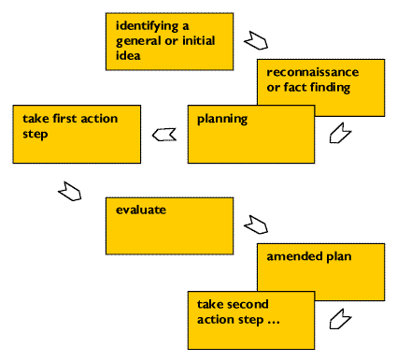
“Spiral of Steps” Cycle

Slide 7
Effectiveness of Field Theory
“Used to analyze the situation as a whole”
Provides overview to counter act repetitive unsuccessful solutions
Show patterns of forces helping or hindering a goal
Determine points of intervention

Slide 8
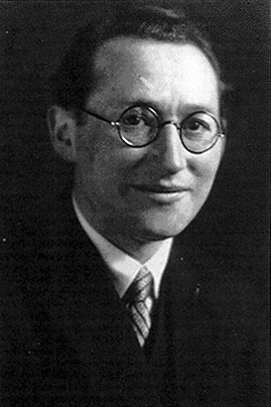
Kurt Lewin – Field Theory
“There is nothing so practical as a good theory.” –Kurt Lewin

Slide 9
Lewin Background
Born September 9, 1890
Moved to Berlin at age 15
1909, began to study medicine
Received doctorate from University of Berlin
1940, became American citizen
1944, Research Center for Group Dynamics
Died February 11, 1947

Slide 10
History
Closely allied with Gestalt psychologists
Emphasized individual’s
Needs
Personality
Motivating Forces
Constructed theory from physics and mathematics

